Slide 1
Six-week Student Exchange Program with France
Armelle Moran
Central Okangan Public Schools

Slide 2
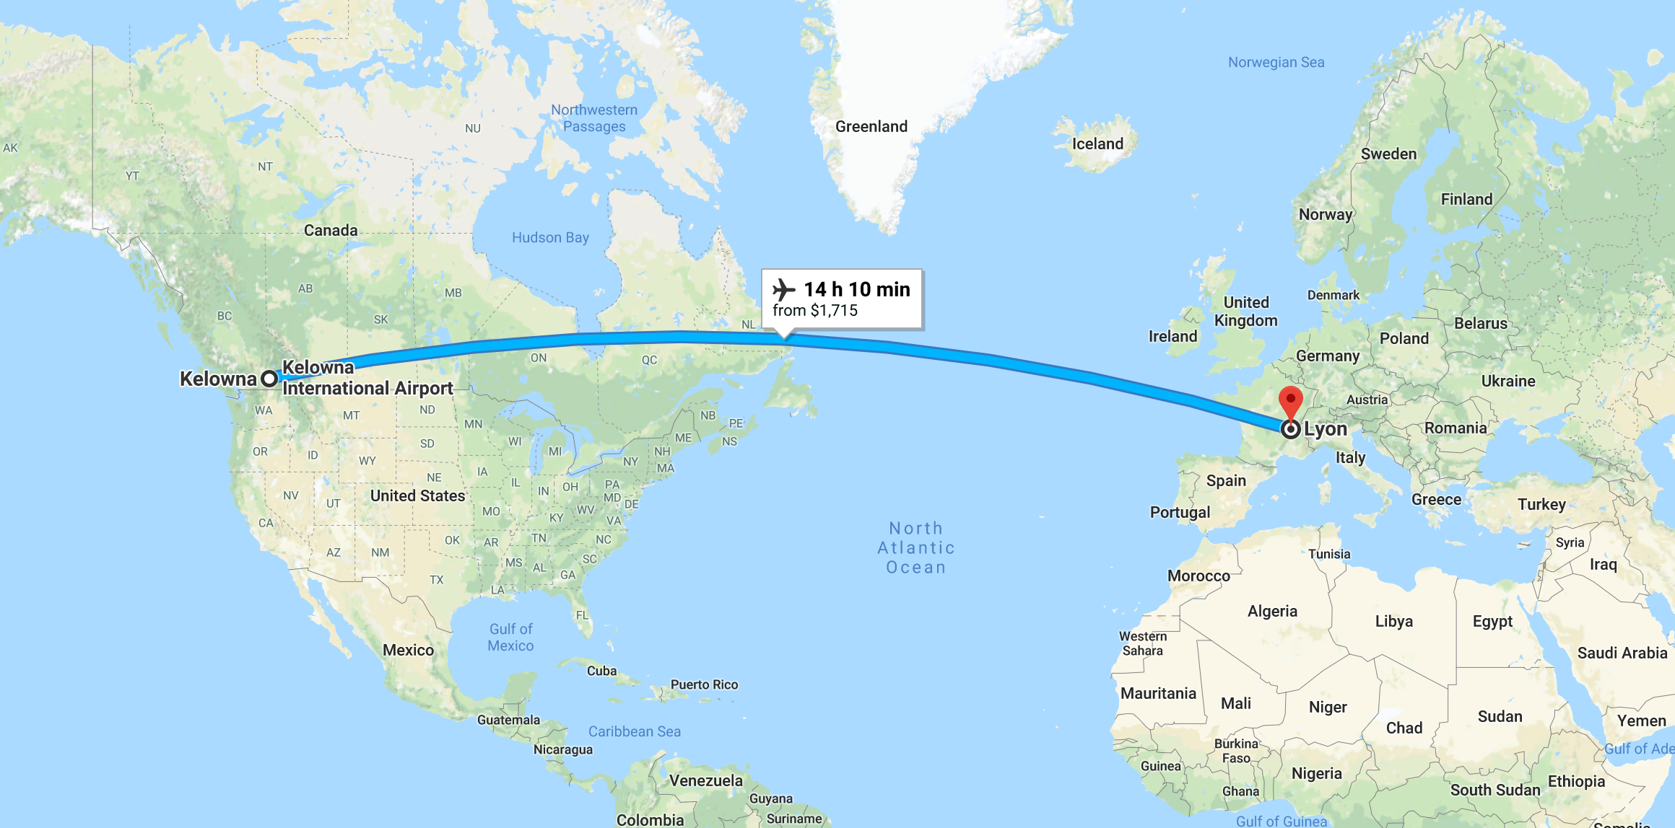
Kelowna to Lyon

Slide 3
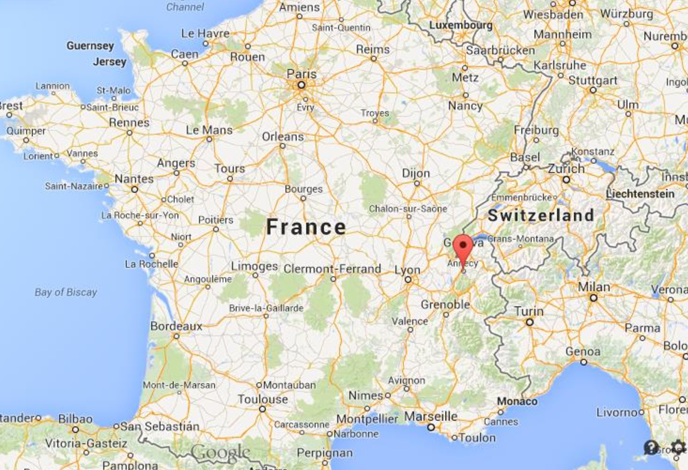
GRENOBLE-ANNECY-RUMILLY

Slide 4
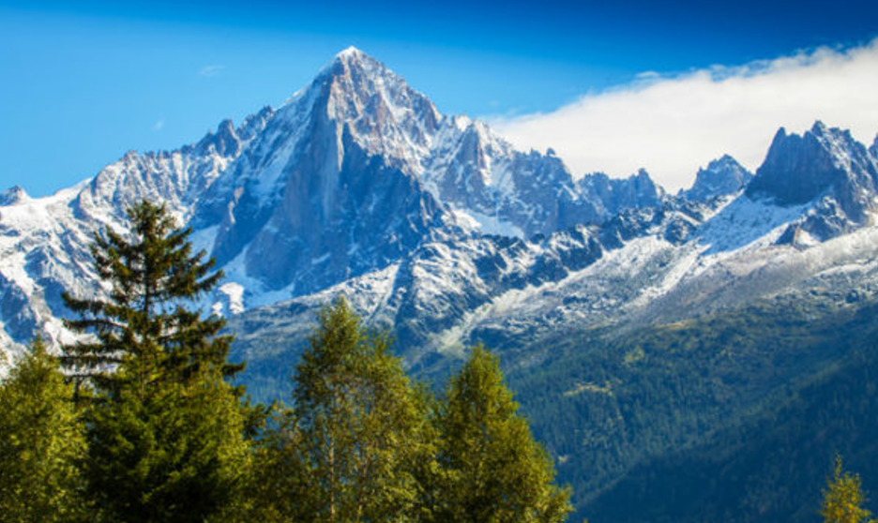
French Alps

Slide 5
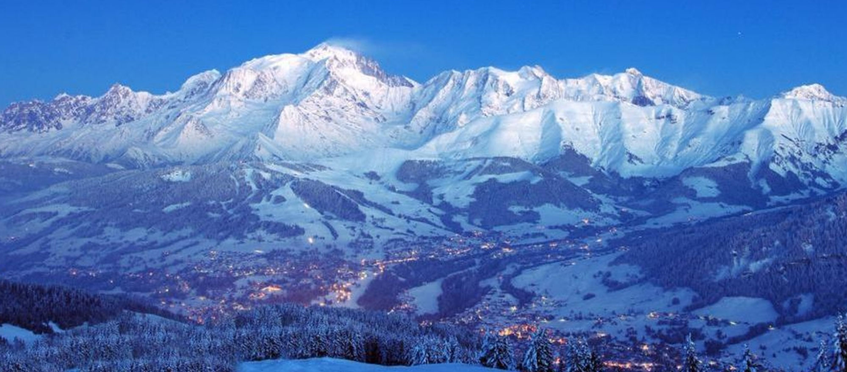
French Alps

Slide 6
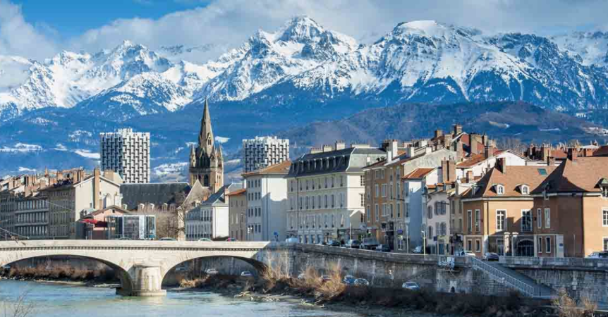
GRENOBLE

Slide 7
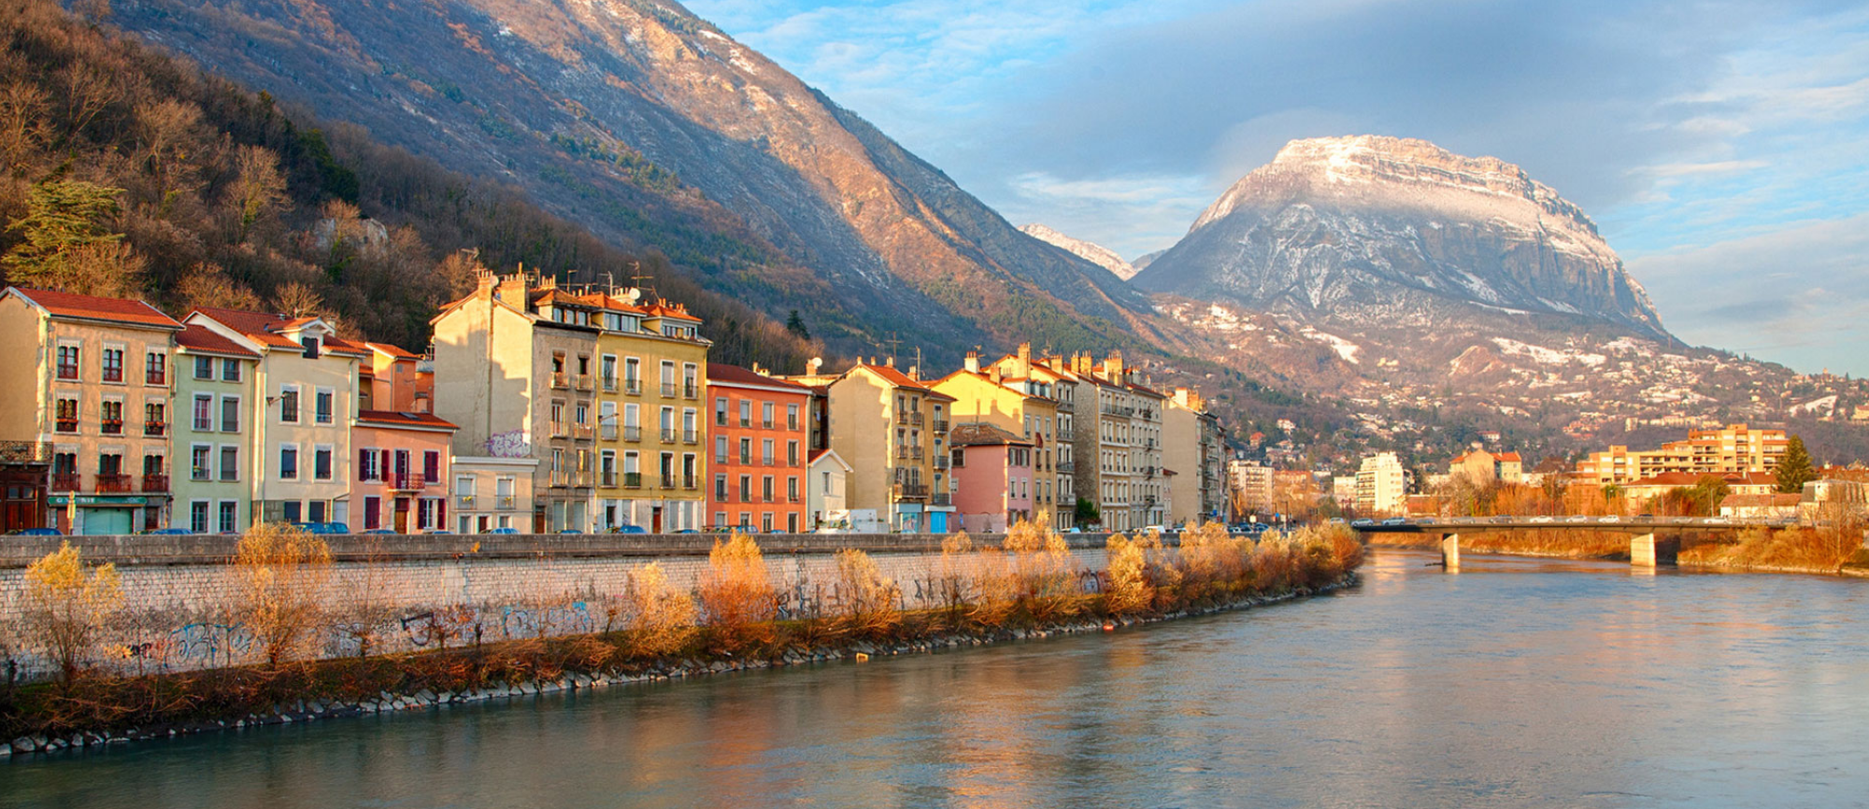
Grenoble

Slide 8
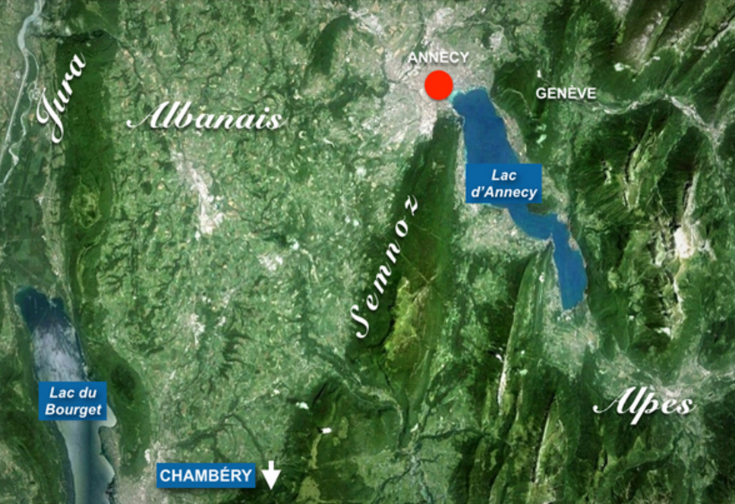
Annecy

Slide 9
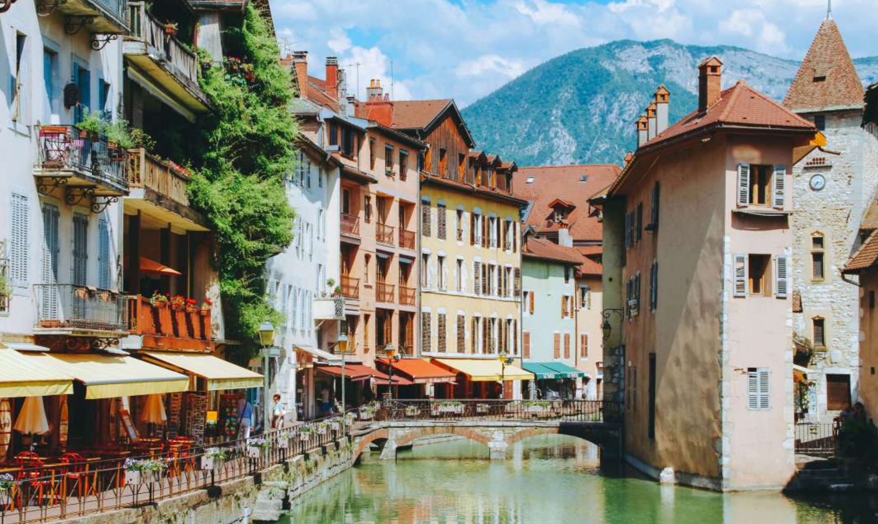
Annecy

Slide 10
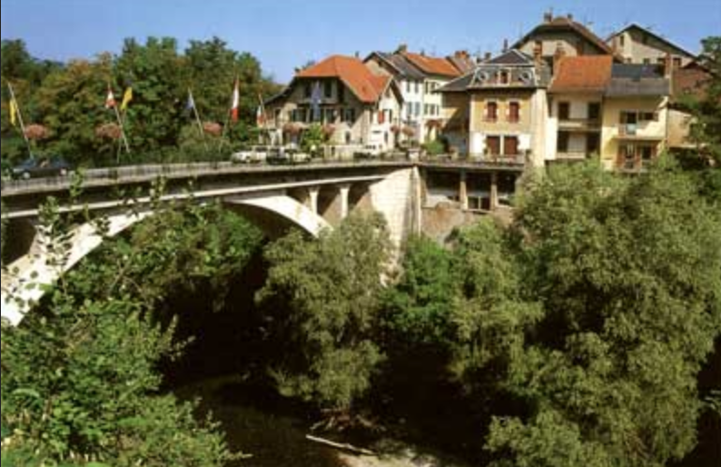
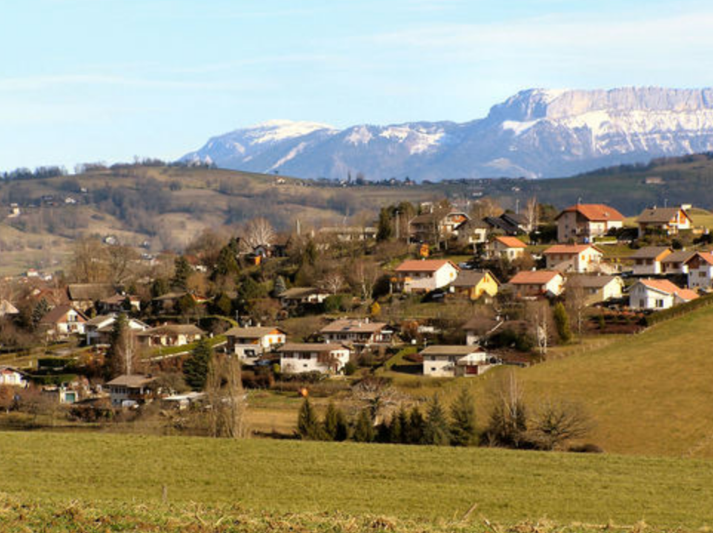
Rumilly

Slide 11
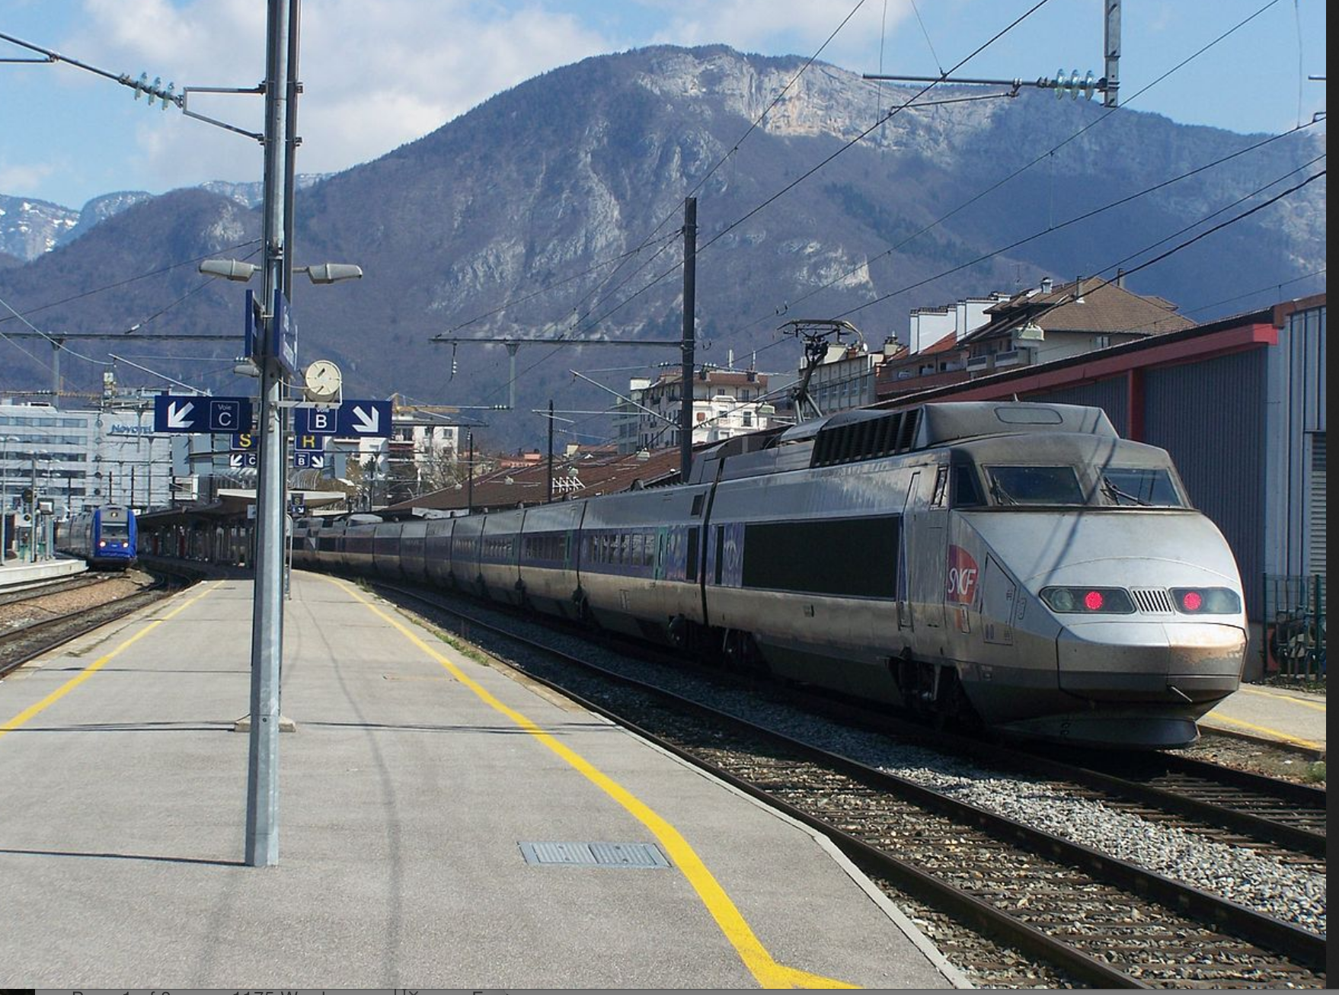
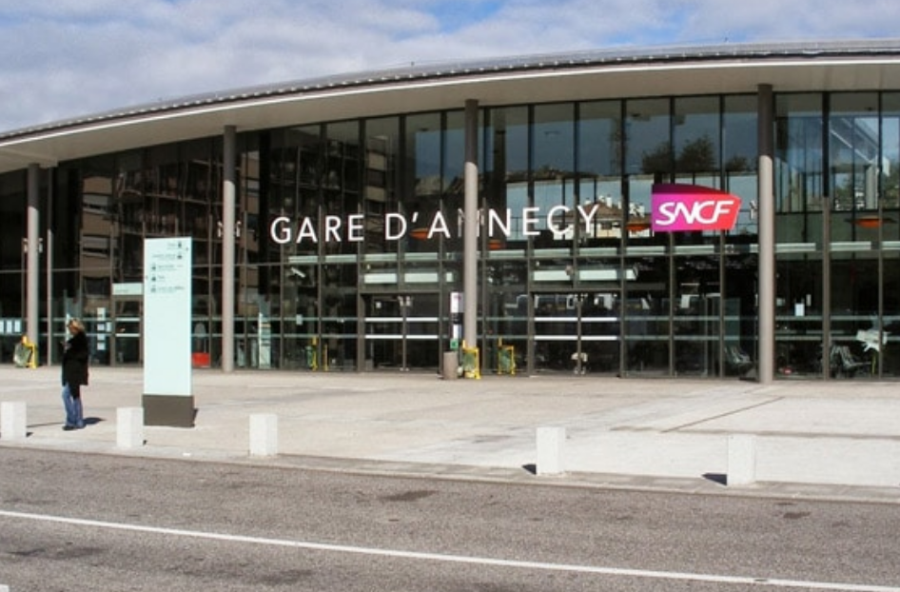
Rumilly to Annecy

Slide 12
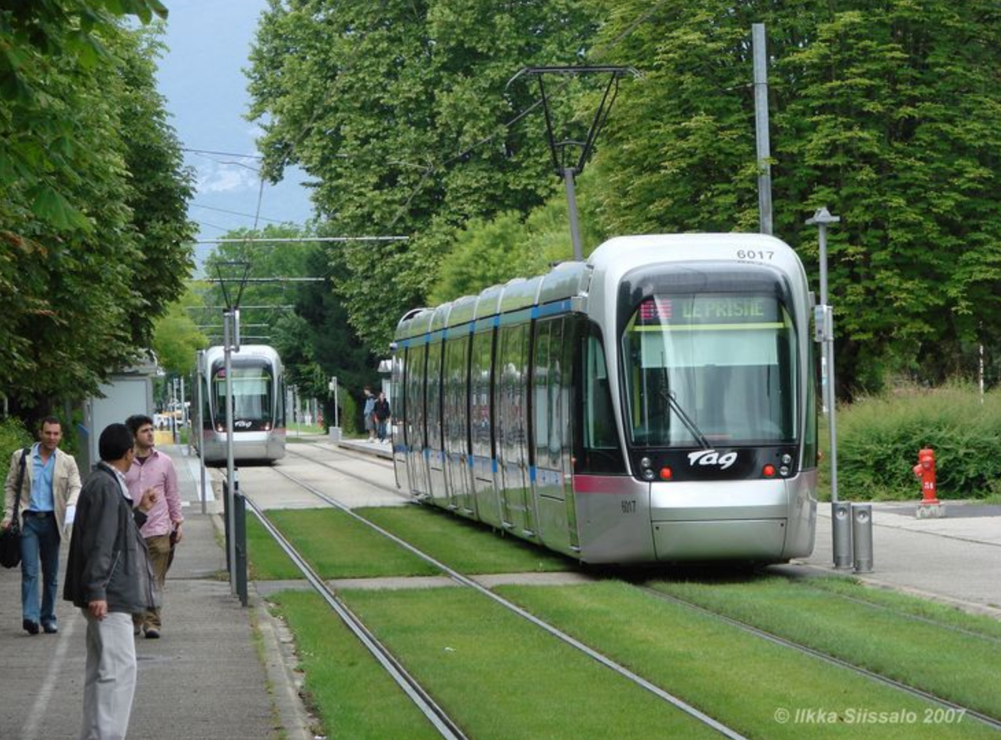
In the city…

Slide 13
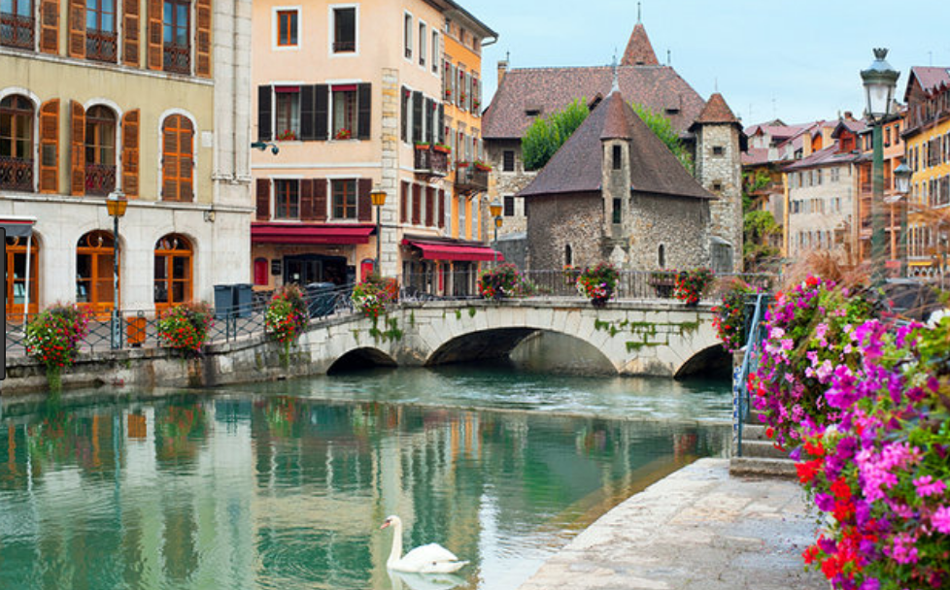
Annecy

Slide 14
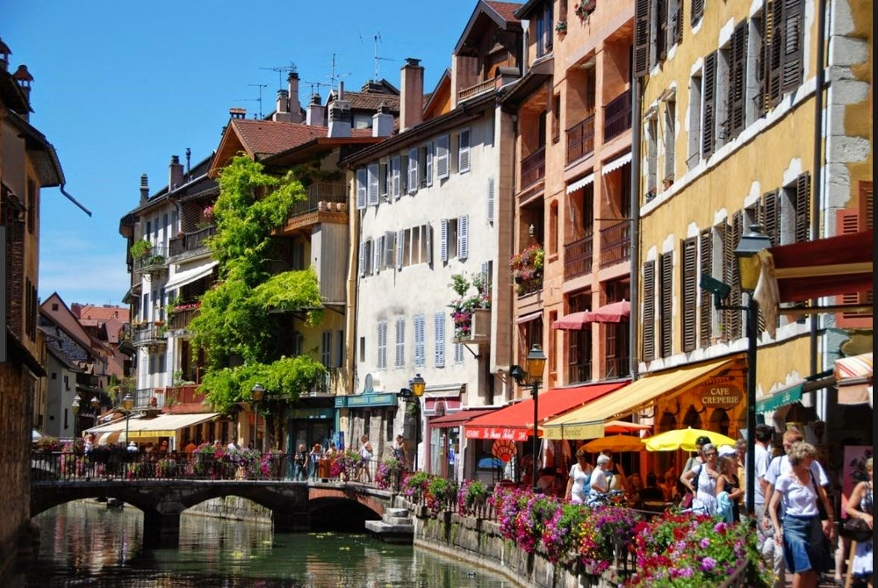
Annecy

Slide 15
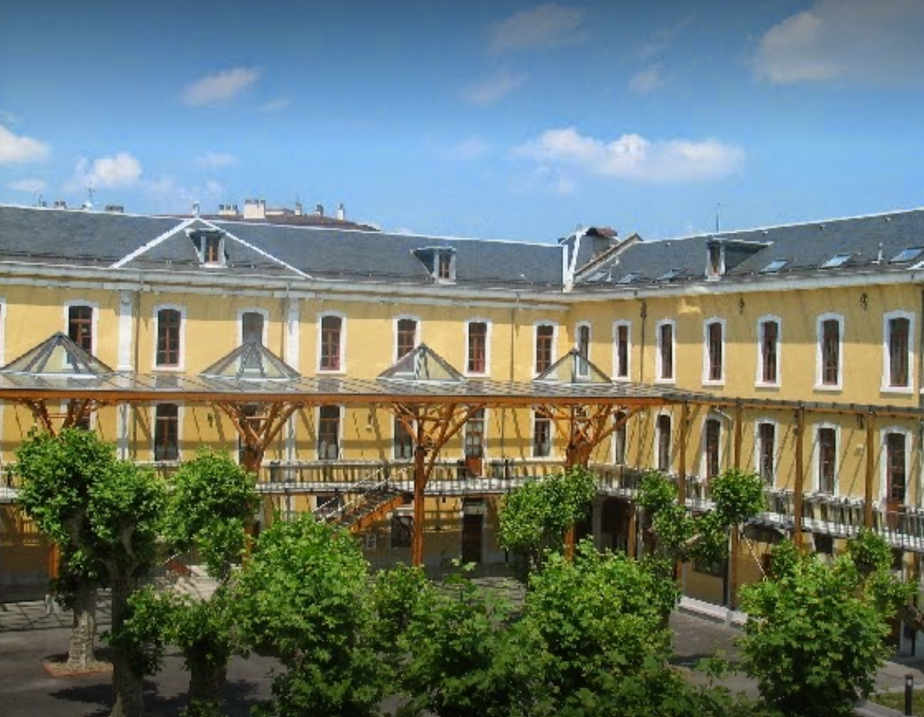
High School in Annecy

Slide 16
Why do this exchange?
To experience a different culture by living the day to day life of a French teenager;
To understand and speak French with ease;
To discover different places with a young person your age as a guide;
To perhaps make a life-long friend somewhere across the world…

Slide 17
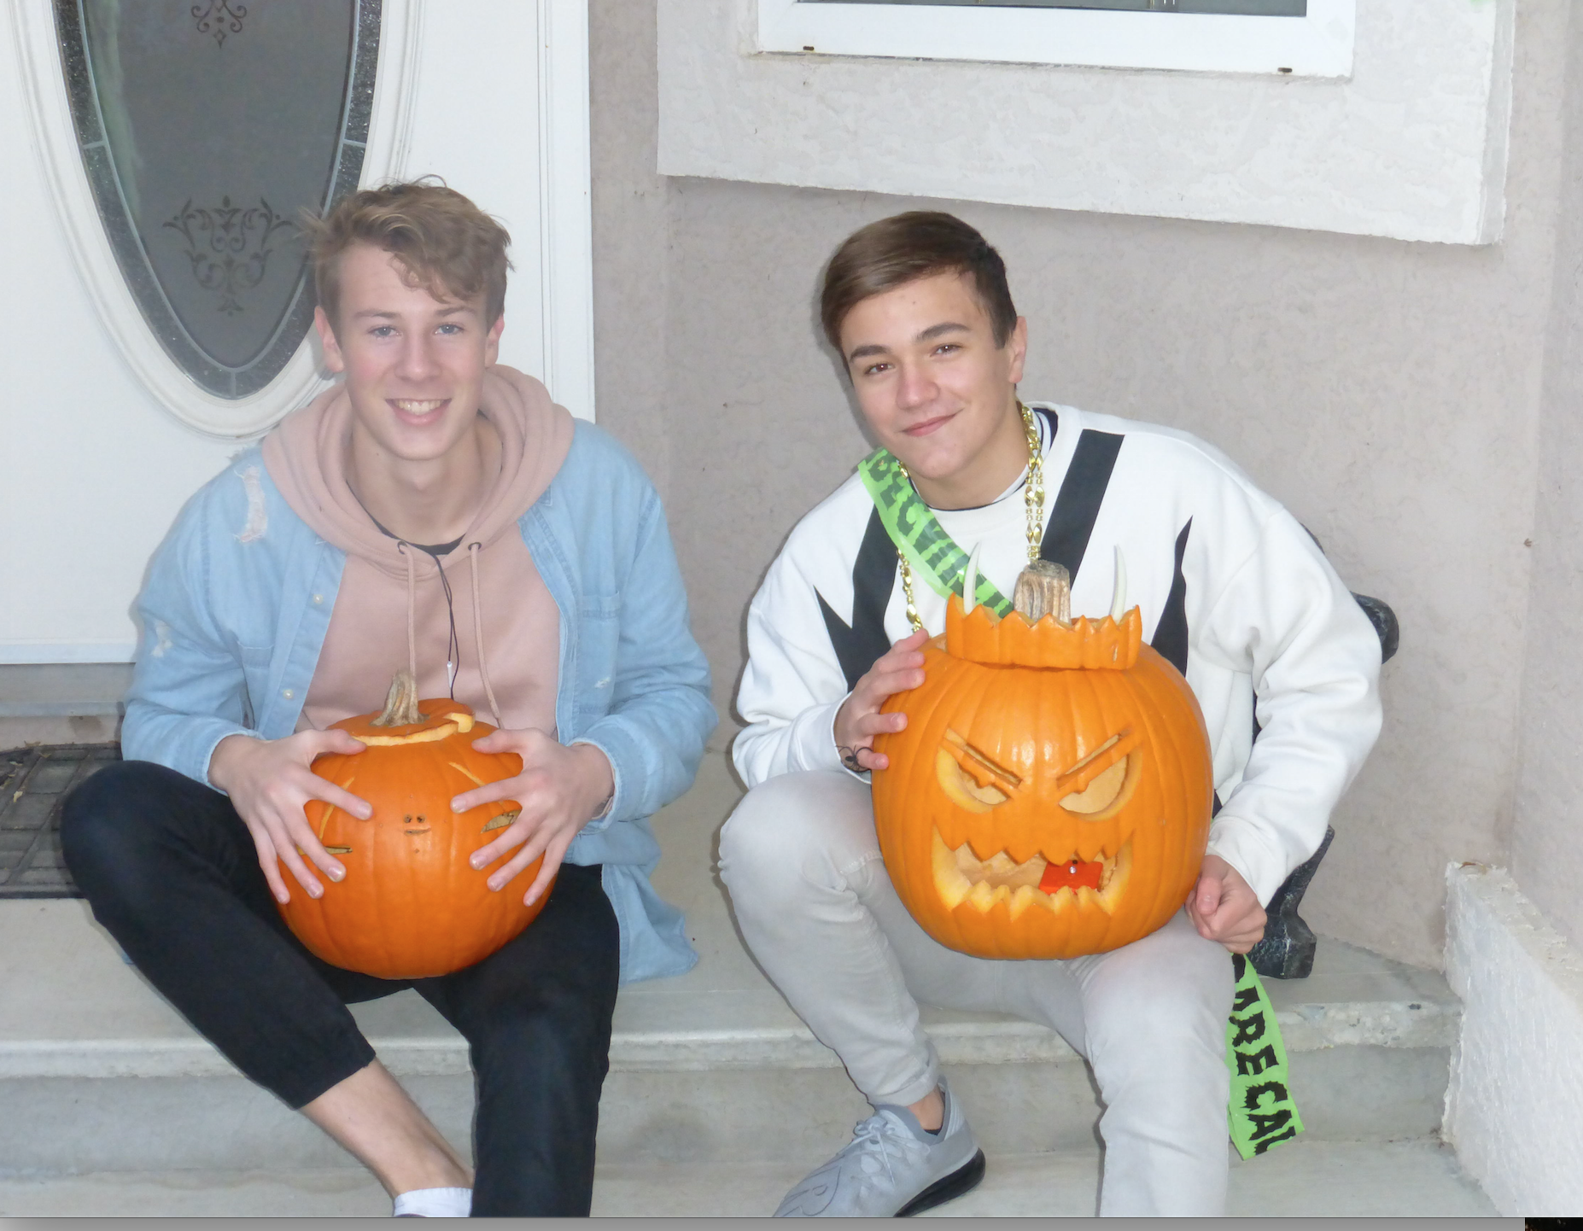
A KSS student’s experience…
“At first I was hesitant about doing this exchange, but by the time Alexis arrived in Kelowna we had already become friends. If I were to rate it, I’d give it a 10 out of 10! I would definitely do this again if I had the opportunity in the future. This experience was a great way to step out of my comfort zone. “

Slide 18
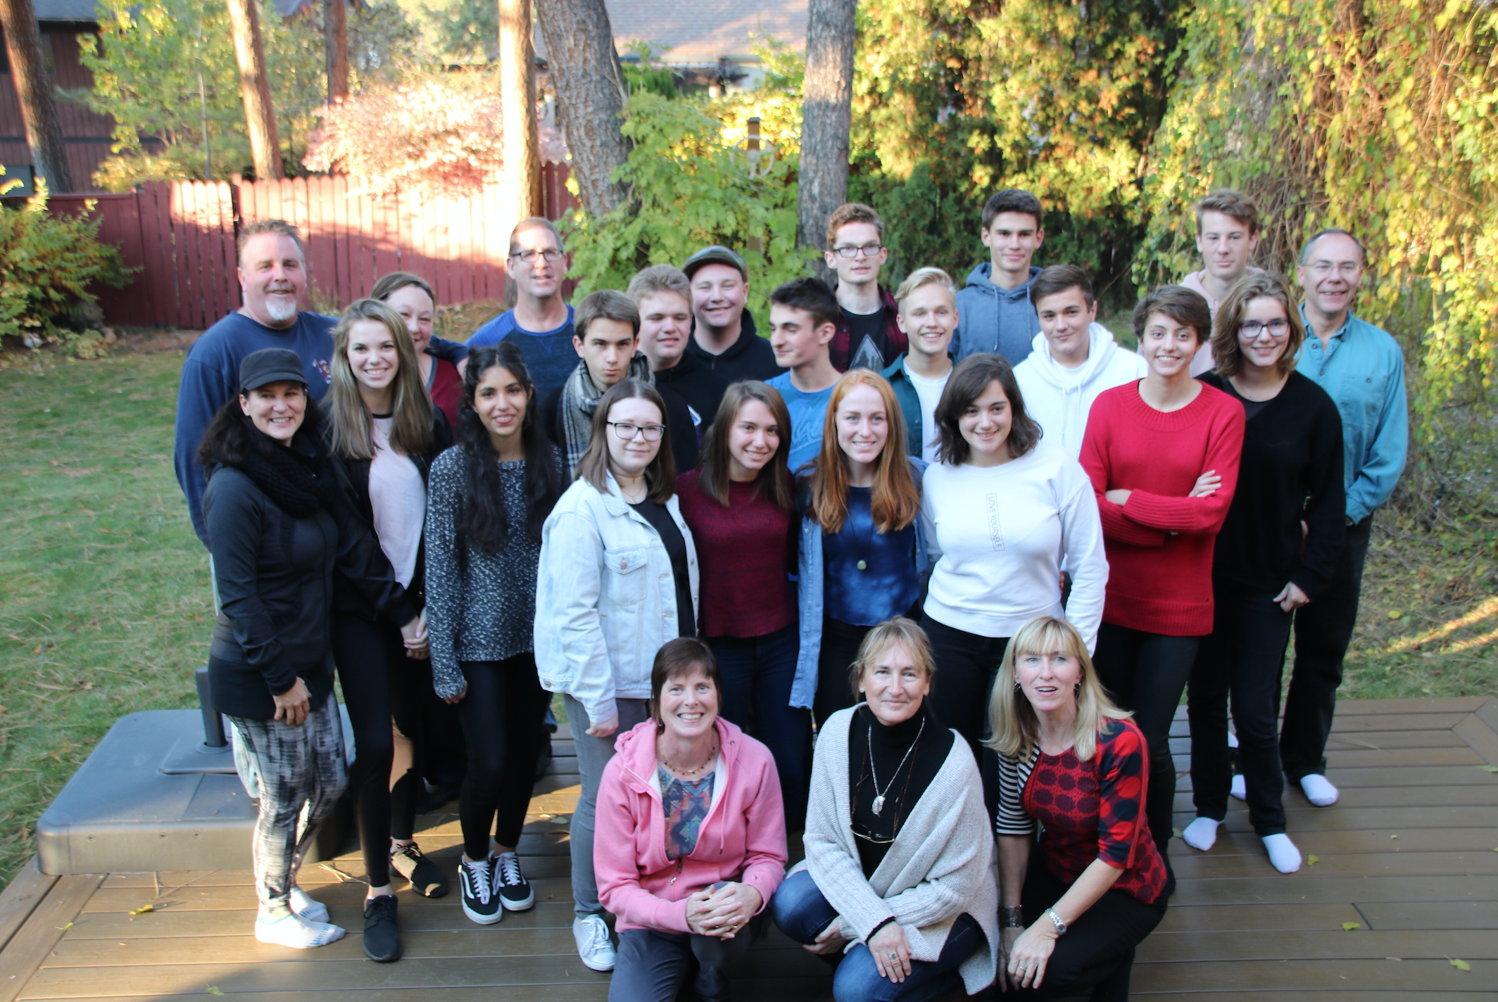
If you are interested…
Cost: Flight Kelowna to Lyon and return
When: French students come in October; you would go to France in March
Information meeting with parents and students:
Monday February 19th 2018 at KSS at 6pm
Application forms due March 1st

Slide 19
Questions to ask myself…
Am I open to and curious about different ways of being in the world?
Am I able to easily adapt to different situations?
Do I laugh easily about awkward situations?
Would I be ready to thoughtfully include someone I do not know very well into my daily life?
Would I be ready to fully participate in the daily life of a family that I do not know?

